Slide 1
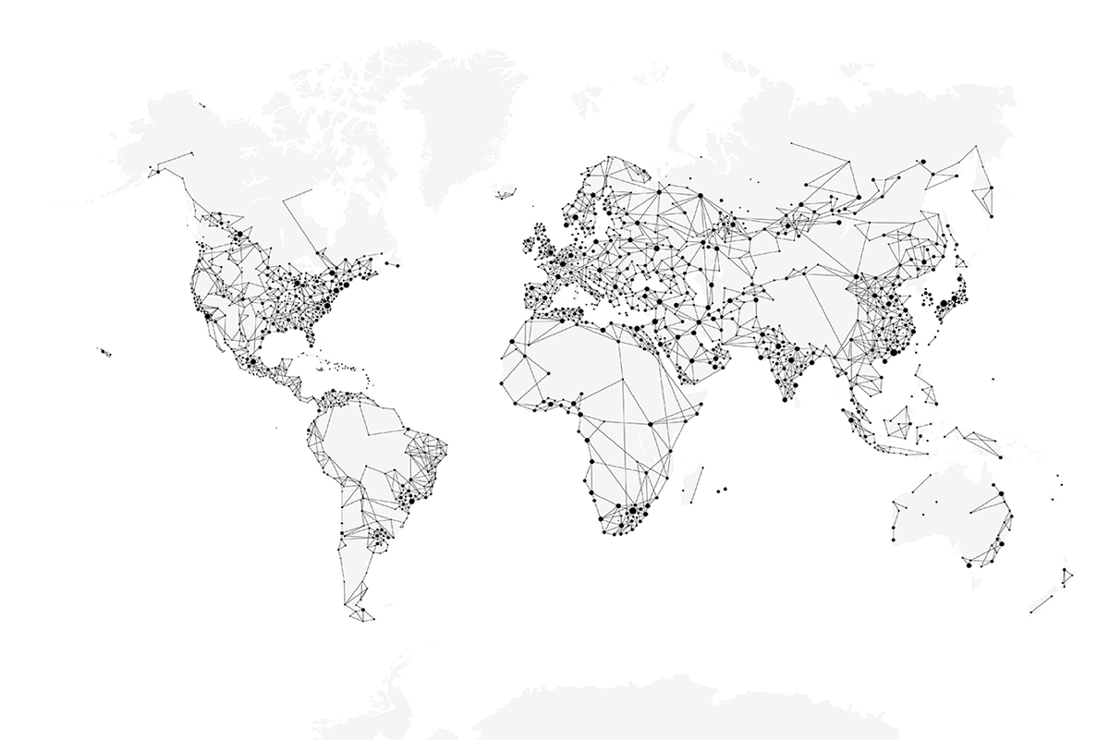

____________( Heading)
________________( Business/Division)
____________ 2025 ( Date)
Classification: Internal

Slide 2
Production Planning
Production planning in manufacturing is the process of organizing resources, machines, and materials to meet demand efficiently while minimizing waste and delays. It ensures that the right parts are produced at the right time, in the right quantity, and on the right machines.
Key Elements of Production Planning
Demand (Indent) → How much needs to be made each day or month.
Capacity → How many hours machines can run.
Inventory → How many parts are already in stock.
Scheduling → Deciding which part to make first, on which machine and how much .
Resources → Machines, tools available for each part, colors, and terminals needed for each part.
Rules → Limits that must be followed, like safety stock, or machine restrictions.
Benefits of Good Planning
Work runs smoothly.
Machines are used well, not left idle.
Less waste of time and materials.
Products are ready when needed.
Costs stay lower.
Classification: Internal

Slide 3
Production Planning
Common Challenges in Production Planning
Machine Breakdowns: Equipment failure disrupts schedules and forces replanning.
Material Shortages: Raw materials or terminals may not arrive on time, blocking production.
High Changeover Times: Switching machines between different parts/colors consumes valuable hours.
Labor Issues: Shortage of skilled operators or unexpected absenteeism affects capacity.
Data Accuracy: Wrong or missing information in planning leads to poor decisions.
Coordination Gaps: Miscommunication between planning, procurement, and shop floor teams causes delays.
Classification: Internal

Slide 4
Where We Are and Where We Want to Be
Current Scenario
Manual Planning
Inventory Management
Gap
Involves 2 – 3 peoples and is time consuming
Some Parts are overproduced/ some may have shortage
To Be
Automated
Maintain 3 day safety stock
Machine Utilization
No proper track of machine utilization, while some machines are on PDT
As per production scheduling
Classification: Internal

Slide 5
Digital Production Scheduling
A smart, automated system that creates production plans using real-time data from demand (indents), inventory, and machine capacity.
What problem it solves:
Removes manual planning that is slow and error-prone.
Balances demand with available machine hours.
Reduces overproduction and shortages by maintaining safety stock.
Tracks machine utilization properly.
Cuts down wasted time from frequent changeovers.
Why it should be used:
Faster and more accurate planning.
Clear visibility of what needs to be produced and when.
Better machine utilization and fewer idle hours.
Lower costs and smoother shop floor operations.
Easy to adjust when demand or machine status changes.
Classification: Internal

Slide 6
Where to Implement ?
Implementation Area:
This system will be implemented in the Moulding Section of part production.
Why Moulding Section Was Selected
Manual Planning:→ Currently, planning is done by 2–3 people, which is slow and time-consuming.
Inventory Issues: → Some parts are overproduced while others face shortages, leading to imbalance.
Machine Utilization Gaps: → No proper tracking of machine usage; some machines remain idle or on downtime.
High Impact Area: → Moulding is a critical stage in part production, so improvements here directly affect overall efficiency.
Best Fit for Automation: → The section has clear demand (indents), measurable machine hours, and visible inventory — making it ideal for digital scheduling.
This section has the biggest gaps between current practice and desired goals, and digital production scheduling can directly solve them — making it the best starting point for implementation.
Classification: Internal

Slide 7
Important Guidelines
Ensure every slide has a page number written on bottom right side. Exclude writing page number on cover slide.
While counting total number of slides of the presentation include cover slide and thank you slide. Count first slide, which is also the cover slide, as slide number 1.
Total number of slides= Cover Slide + Thank you Slide + All inner slides
The thank you slide has clickable links to our official social media handles in the form of icons. These links open to their respective handles. Please ensure the links are clickable at all times.
Editable items in cover slide are Presentation title, month & year. Email ID, address (if applicable) in the thank you slide.
DO NOT TAMPER with the design of the PPT.
Classification: Internal

Slide 8
Constraints Implemented in Digital Production Scheduling
Maintain Safety Stock
Full Capacity Utilization
Fixed Machine Allocation
Plan According To Category
Minimum Changeover
Terminal Availability
Classification: Internal

Slide 9
Maintain Safety Stock
To maintain a minimum 3-day safety stock for all parts, ensuring uninterrupted production flow and safeguarding operations against downtime, demand fluctuations, and unforeseen uncertainties.
This buffer acts as a protective layer that keeps the line running smoothly even when unexpected delays, machine breakdowns, or supply disruptions occur.
1-2 D
2 – 3 D
4D
5D Target Level
TARGET STOCK : 3 days Safety stock + 2 days rolling stock
1-2 D | 2 – 3 D | 4D | 5D Target Level
0 Stock
Safety Stock
Rolling Stock
Case-0
S - 1
S - 2
S - 3
Stock = 1 - 3D
Stock > 3D
Maintain Production Flow
Stock < 1D
Urgent Production
Balance shortage and stable part
Maintain Production Flow
Optimize machine Efficiency
Classification: Internal

Slide 10
Plan According To Category
“Schedule production based on the type of part, ensuring the right balance between fast-moving and slow-moving items, by classifying them into categories such as Runners and Strangers.”
“This approach allows the system to prioritize urgent requirements, maintain steady flow for medium-demand items, and strategically plan low-demand parts without wasting machine capacity.”
Runners: Fast-moving parts, high demand, produced frequently.
Repeaters: Moderate demand parts, produced regularly but not daily.
Strangers: Slow-moving parts, low demand, produced occasionally.
Categories
Runner
Repeater
Stranger
Prioritize Frequently
Plan at Intervals
Plan Strategically
High Indent
Frequent Production
Regular Planning
Avoid Shortages
Occasional Demand
Slow Moving

Slide 11
Full Capacity Utilization
“Ensure all machine hours are fully utilized, maximizing productivity and minimizing idle time. The system balances workloads across machines and keeps production running smoothly.
2 shifts × 12h | 1h break each = 11h per shift = 22h per day
Total Available Hours = 22
Subtract Downtime and Changeover
Allocate Parts to Machine
Balance Workload Across Machines
Achieve Full Capacity Utilization

Slide 12
Fixed Machine Allocation
“Machines assigned to certain parts always run those parts and aren’t included in planning or reallocation. These machines are fixed because their parts need full machine capacity. Keeping them dedicated saves time, reduces changeover costs, and keeps production steady and efficient.”
Check Machines
Is it fixed ?
YES
Skip It !
NO
Plan Parts on it

Slide 13
Minimum Changeover
To reduce the number of machine changeovers in a day, saving time and cost while keeping production efficient. The system sets a maximum of 25 changeovers per day and intelligently sequences parts to minimize setups. Wherever possible, it groups parts of the same color together, so machines can continue running without frequent adjustments. This approach reduces wasted time, lowers changeover costs, and ensures machines spend more hours producing rather than stopping for reconfiguration.
Daily Changeover Limit = 25
Is changeover within limit
No
Shift to next day
Group same color part together
Allocate Parts To Machines

Slide 14
Terminal Availability
“To ensure that parts are scheduled only when the required terminal or terminals are available, so production can run without interruptions or conflicts. Each part depends on specific terminals for its processing, and the system checks their availability before confirming any plan. If even one required terminal is unavailable due to downtime, overload, or maintenance, the part cannot be scheduled until all necessary terminals are active. This prevents scheduling errors, avoids bottlenecks, and ensures that production flows smoothly.”
Terminals Required For a Part
All Terminals Available ??
YES
Plan this part
Skip to other parts

Slide 16
WHAT THIS PRESENTATION COVERS
10 constraints — each explained with the problem it solves, the mechanism, and the flowchart
C1
Inventory Health
C6
Minimum Tools
5-Day target with safety floor & ceiling
1→2→3 tool escalation logic
C2
Priority Scoring
C7
Serial Tool-Changer
Urgency-first assignment, displacement pass
Structural no-overlap guarantee
C3
22-Hour Rule
C8
Minimum Run Block
Two-shift planning with hard ceiling
4-hour effective production floor
C4
Specialised Machines
C9
No Machine Idle
Part-count based machine ranking
90% utilisation enforcer — uncapped extension
C5
Same-Part Continuation
C10
Colour Grouping
Changeover minimisation & queue stagger
10-min purge penalty & colour-aware ranking
Classification: Internal
Smart APS V9 | Uno Minda Rika Private Limited | Injection Moulding Division

Slide 17
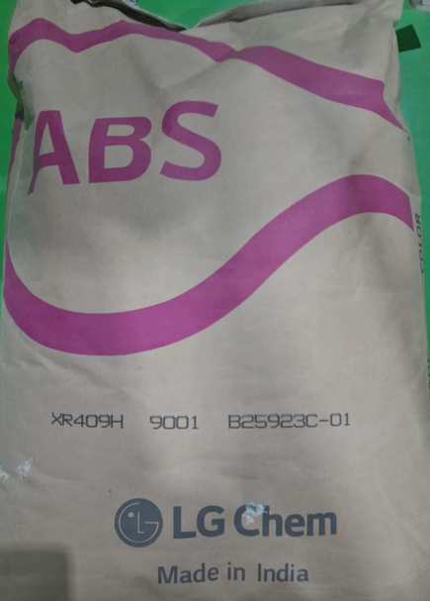
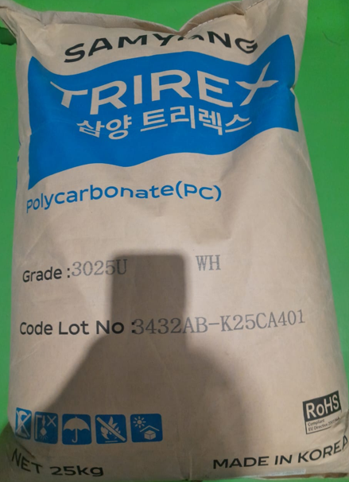
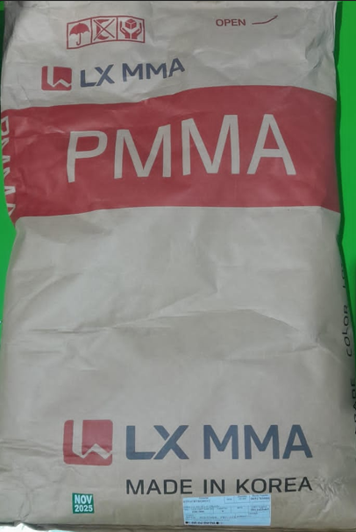
14SW210301-00004X1 KNOB PWS CP
RTPABSBKG0027Y
ABS XR-409H (BLACK) OF LG
RTPPOCWHG0012Y
PC-TRIREX 3025U(WHITE) OF SAMYANG
RTPACRTRG0012Y
PMMA I.G. 840 OF L.G. (TRANS)
Classification: Internal

Slide 18
Font Specification
Heading….. (32, Calibri, Black, Bold)
Sub Heading…. (28, Calibri, Black)
Contents…. (minimum 18 - 24, Calibri, Black) :
Classification: Internal

Slide 19





Thank You
Corporate Office
Address: Village Nawada Fatehpur,
P.O. Sikanderpur Badda, Manesar,
Gurgaon – 122004, India.
Website: www.unominda.com
Email ID: xxxx@unominda.com
Follow us on social media. Links below
Classification: Internal

